Slide 1




Exploratory Study on Wind Tunnel Noise Profiles
Sam Bevier
Mentor: Dr. James Threadgill
Post-doc: Dr. Ashish Singh
Arizona Space Grant Symposium
ONERA
April 20th, 2024

Slide 2
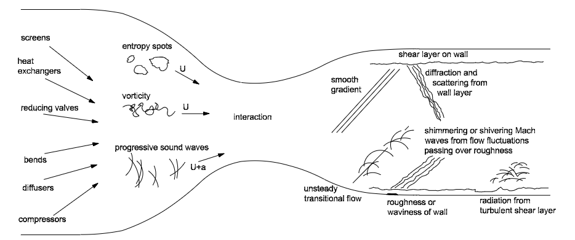
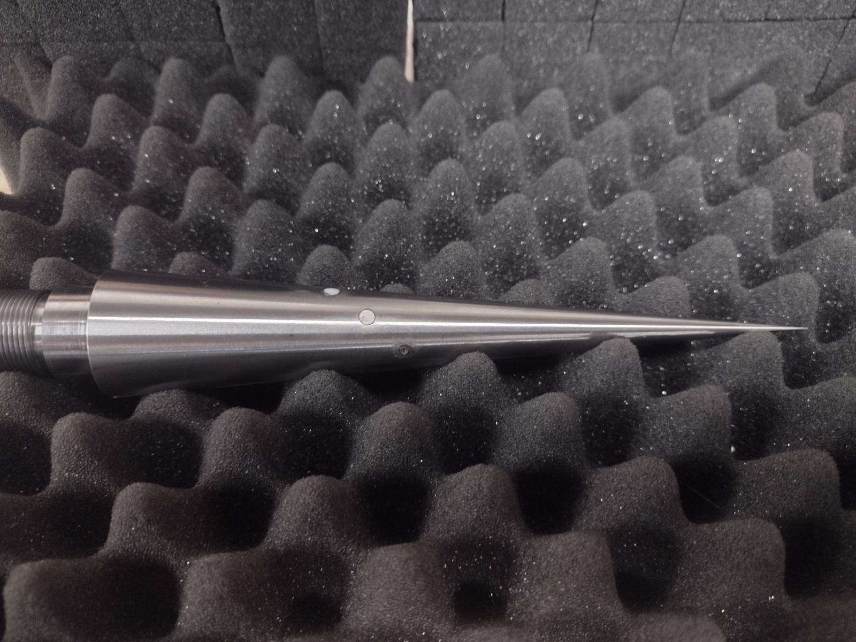
Project Goals
Goal: to compare unsteadiness across supersonic wind tunnels
  Characterize influence on experiments
  Support international collaboration, to compare with wind tunnels across US/Europe
Freestream pressure disturbances are measured to characterize the unsteadiness.
The data acquisition is centered around a precision machined cone provided by ONERA
(Schneider, 2001)

Slide 3
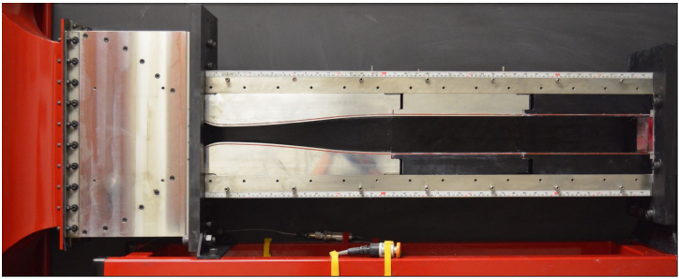
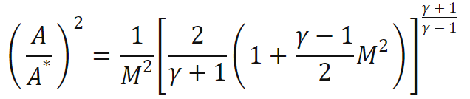
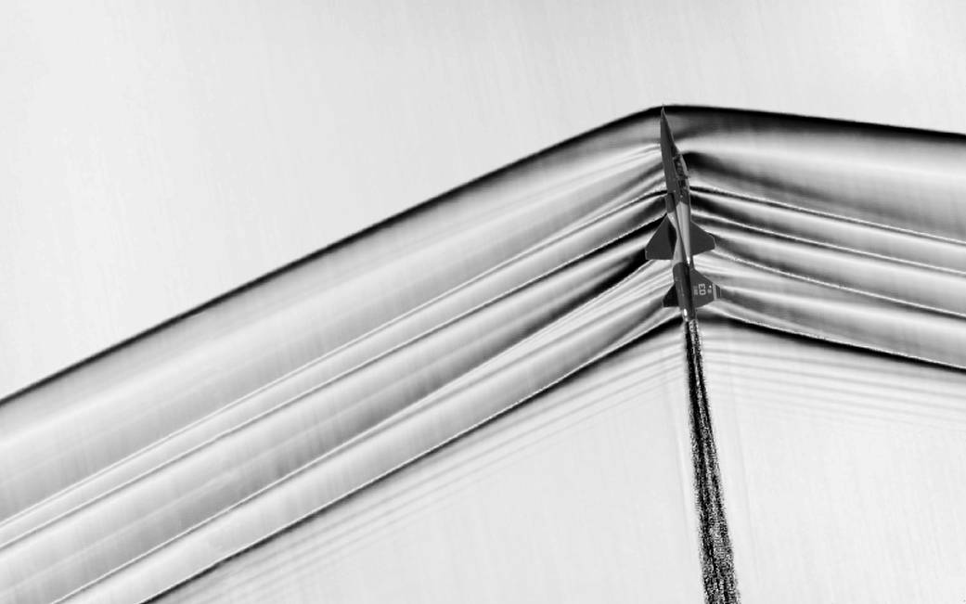
Wind Tunnels
Wind tunnels are used to test experimental models in controlled environments
  ‘Open circuit’ facilities – straight shot
  ‘Close circuit’ facilities – loop
Supersonic wind tunnels are the specific focus of this project
  Flow becomes supersonic by: creating sufficient pressure ratios and specific geometry (contraction & expansion)
  In supersonic flow, shockwaves can form when the flow deflects
(NASA, 2015)

Slide 4
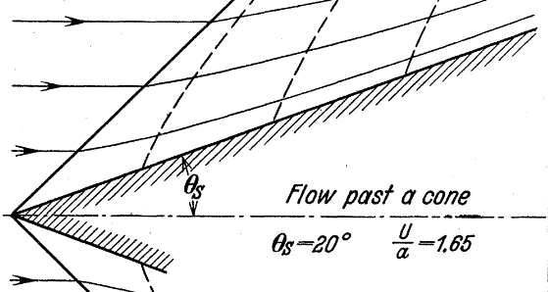
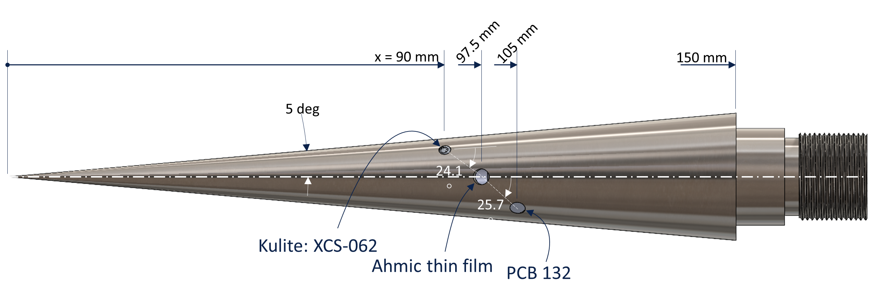
The Cone
The cone is used to place sensors in the freestream flow
The shallow angle and sharpness of the cone mitigate the shockwave
Pressure Fluctuation Sensors:
  Kulite – 0 Hz to 40 kHz
  PCB – 20 kHz to 1 MHz
(Maccoll, 1937)

Slide 5
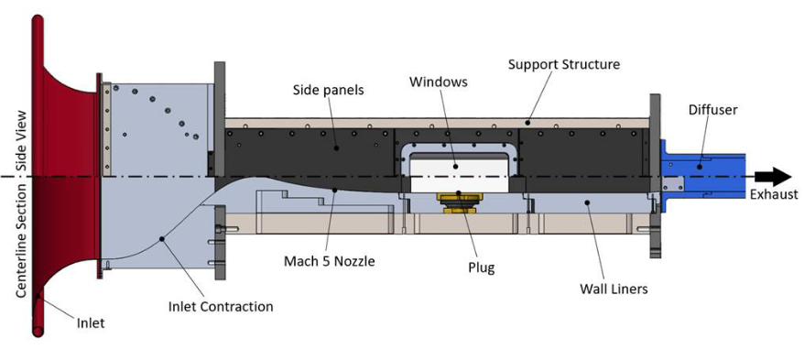
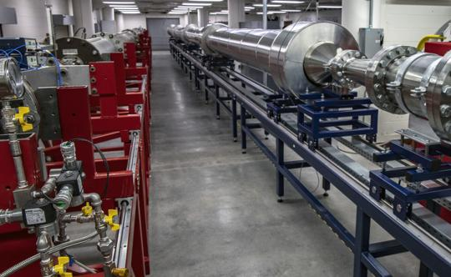
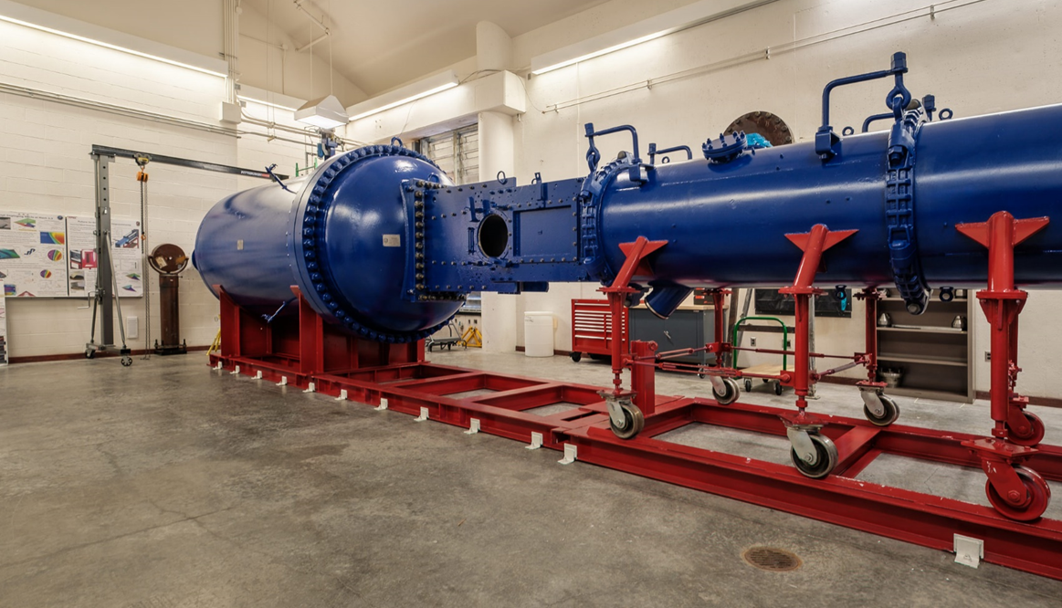
Local Supersonic Facilities
Indraft Supersonic Wind Tunnel
Ludweig Tube Mach 5 (LT5)
Arizona Polysonic Wind Tunnel
Ambient conditions pulled to vacuum.
W: 3.2 in X H: 4.8 in X L: 24 in
Testing Mach numbers:
2.3 | 4.0 | 5.0
Maximum Mass Flow: 2.2 lb/s
High pressures push and vacuum pulls.
Test Diameter (Cylindrical): 15 in
Testing speeds up to Mach 4.8
Maximum Mass flow: 37 lb/s
High pressures push to ambient conditions.
W: 15 in X H: 15 in X L: 50 in
Testing Mach numbers:
1.75 | 2.1 | 2.5 | 3.0 | 3.5 | 4.0
Maximum Mass Flow: 550 lb/s

Slide 6
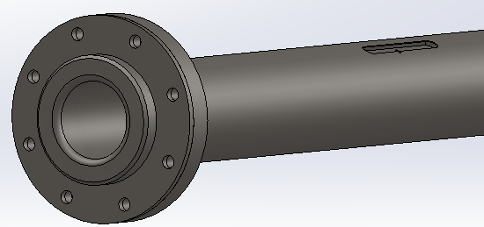
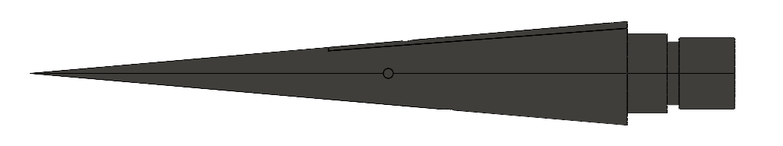
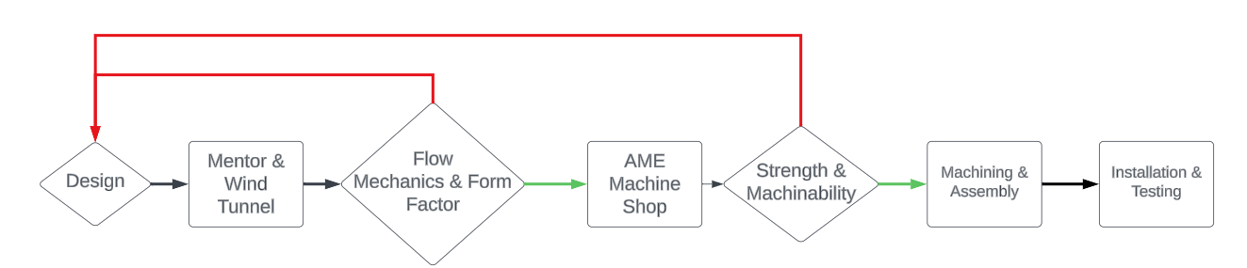
Design Process
Adapter Design
Experimental Model
Wind Tunnel Interface

Slide 7
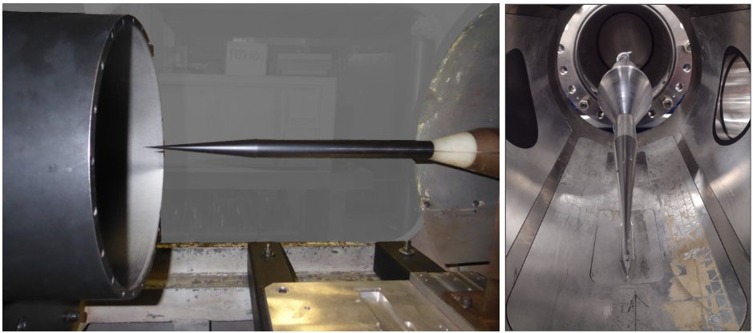
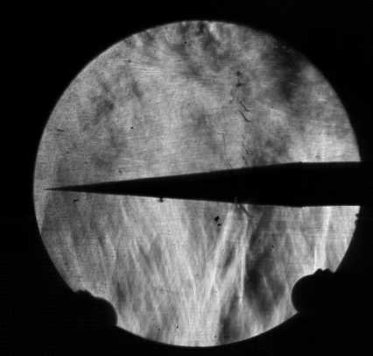
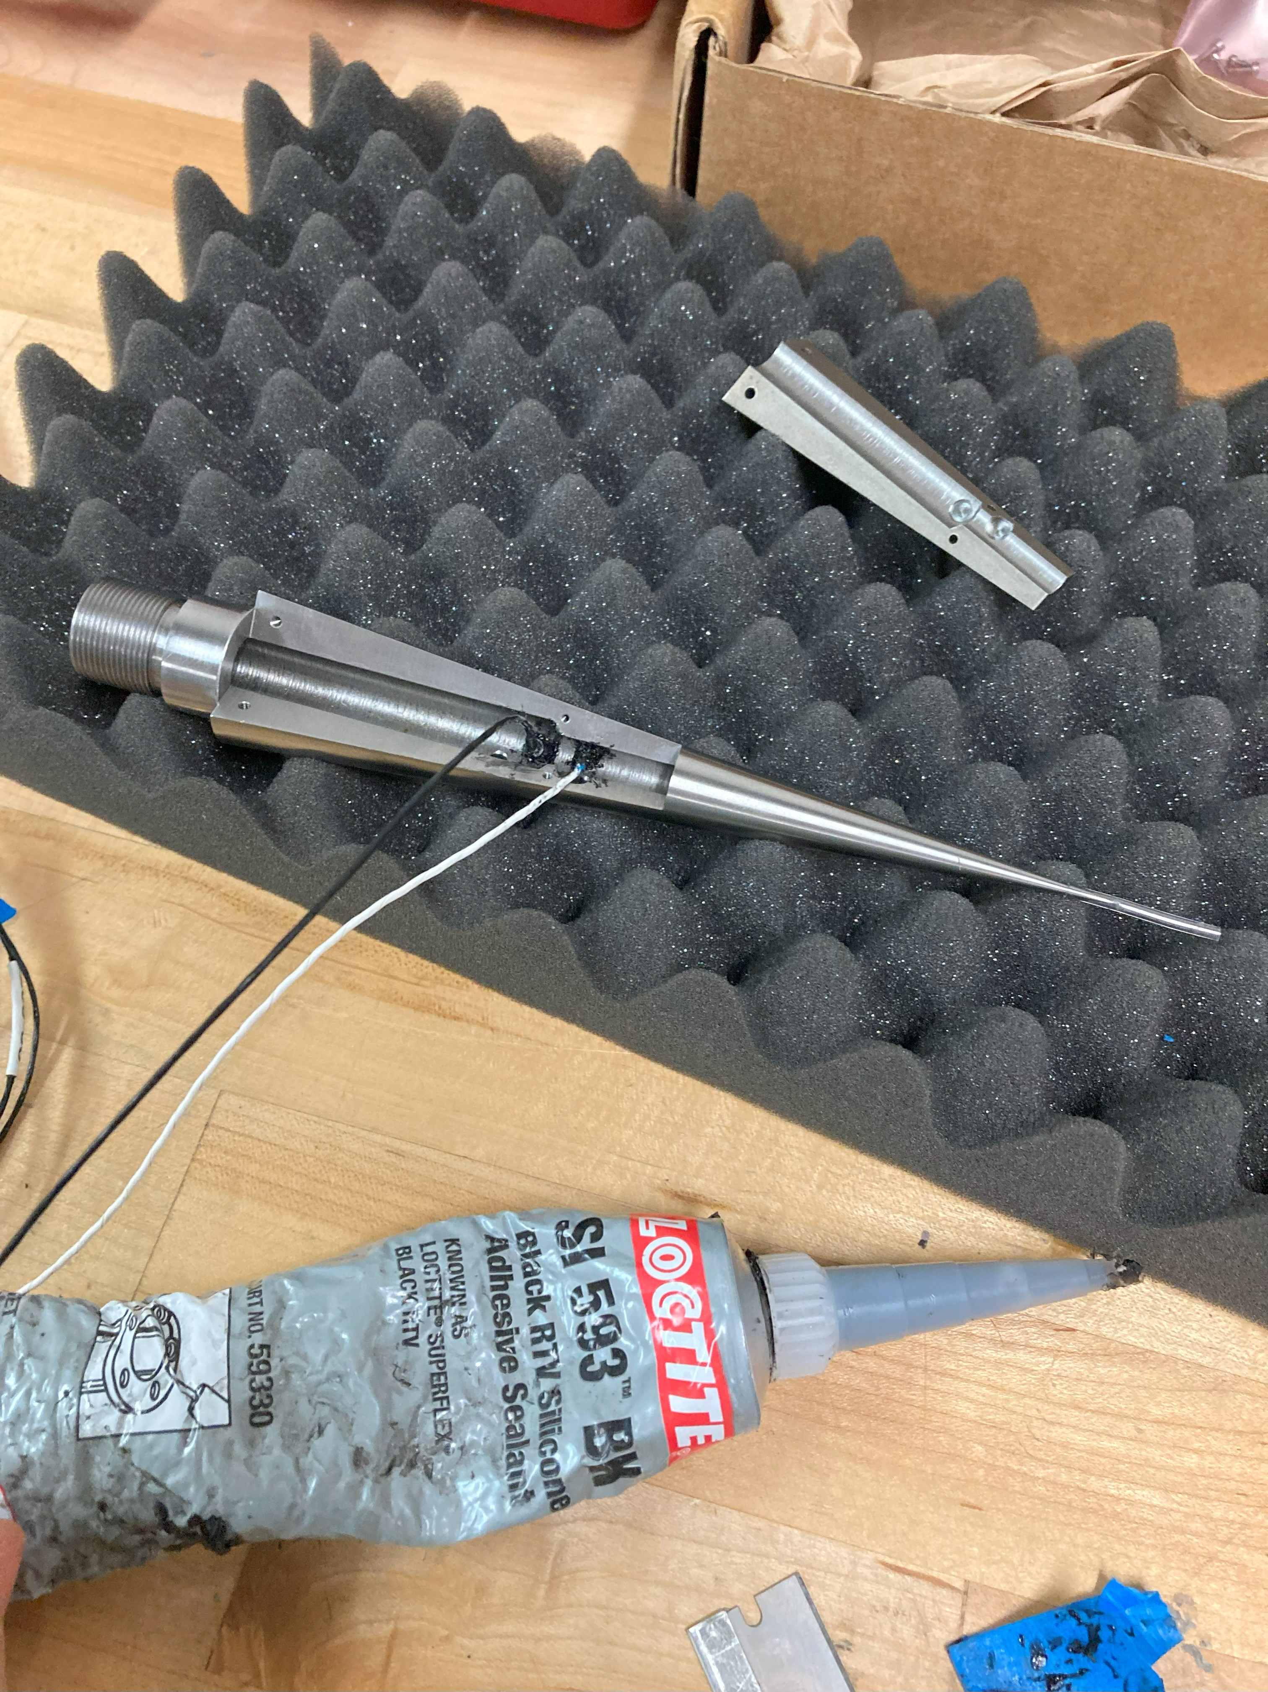
Progress & Results
ONERA R2Ch wind tunnel with the cone
Flow Visualization of flow starting in APWT to supersonic speeds
LT5 test section with the cone installed.
(Flow into the image.)
Sensor Installation

Slide 8
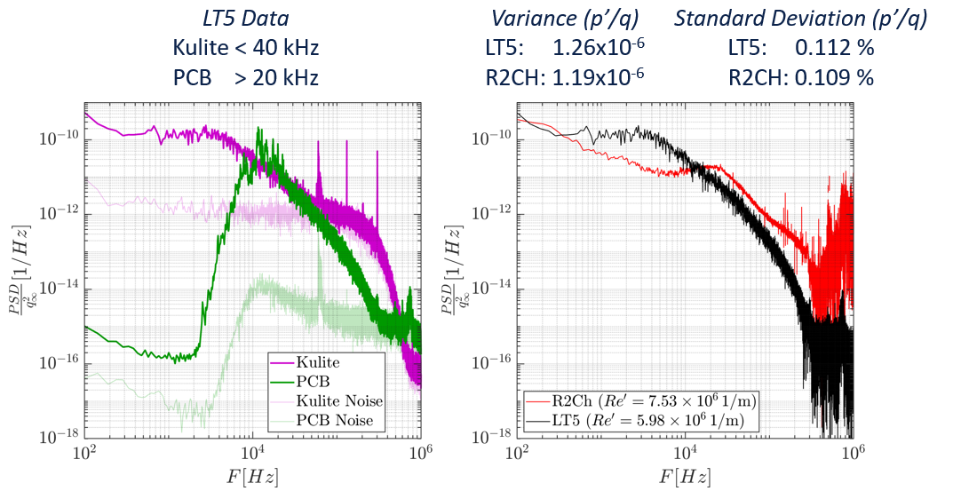
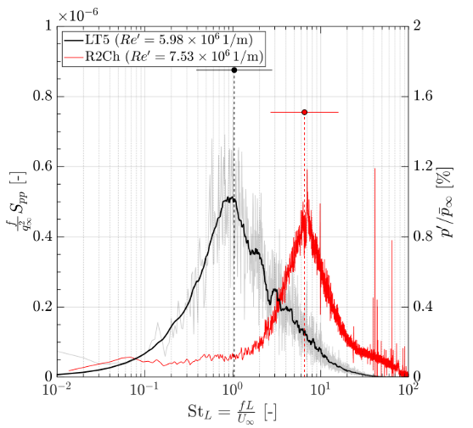
Preliminary Data Analysis
Logarithmic plotting allows for viewing of nonlinear relationships
The graphs represent the frequency (x-axis) and amplitude (y-axis) of the measured fluctuations
(Threadgill et al., 2024)

Slide 9
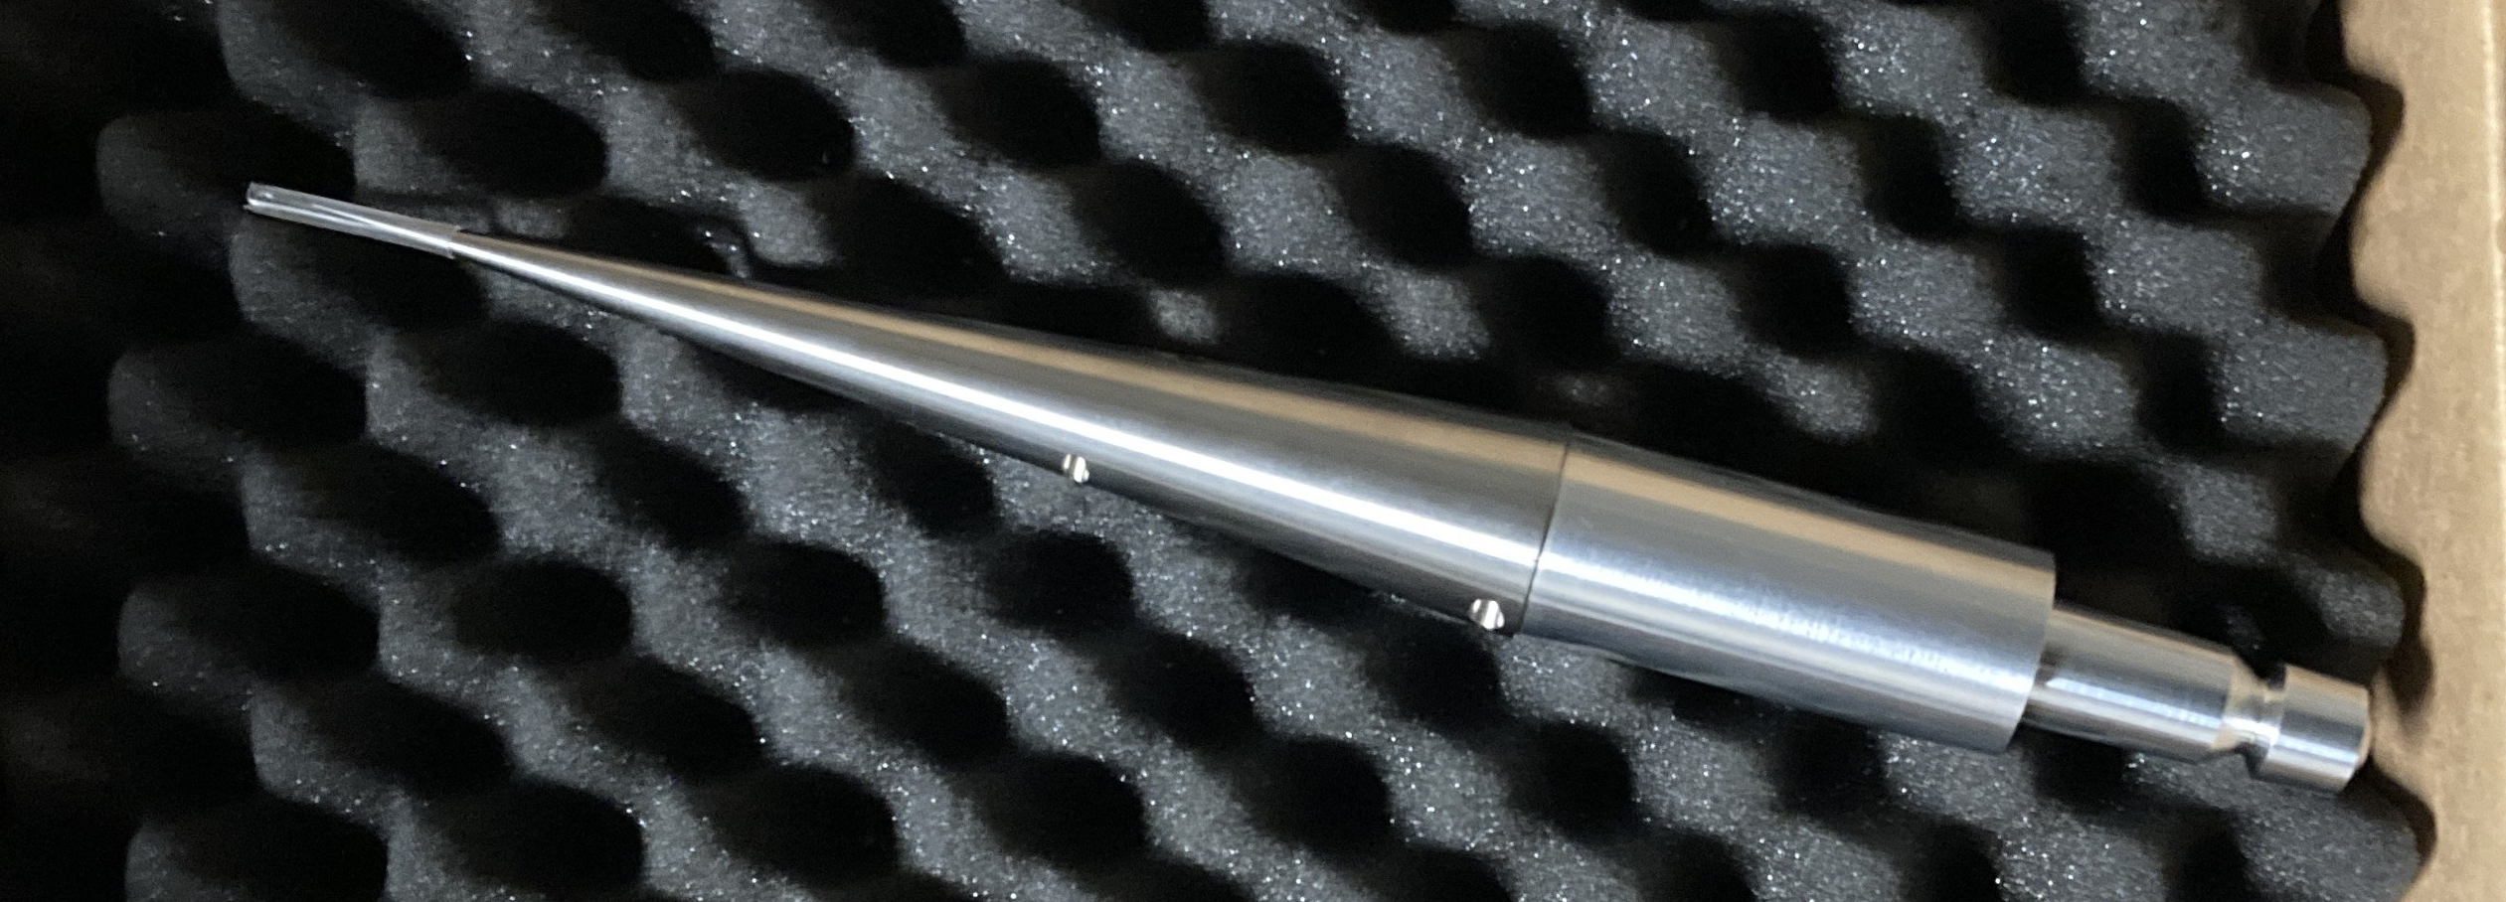
Conclusions
Preliminary analysis of fluctuations in the frequency domain has shown differences in some wind tunnels
Adapters ready for testing in all remaining wind tunnels
Next stage of testing due to be executed in APWT in April, 2024
Further data collection planned for ISWT and other APWT conditions
(Threadgill et al., 2024)

Slide 10
Citations
James A. Threadgill, Christoph Hader, Ashish Singh, Vasilis Tsakagiannis, Hermann F. Fasel, Jesse C. Little, Mathieu Lugrin, Reynald Bur, Giuseppe Chiapparino and Christian Stemmer. "Scaling and Transition Effects on Hollow-Cylinder/Flare SBLIs in Wind Tunnel Environments," AIAA 2024-0498. AIAA SCITECH 2024 Forum. January 2024.
Maccoll, J. W. “The Conical Shock Wave Formed by a Cone Moving at a High Speed.” Proceedings of the Royal Society of London. Series A, Mathematical and Physical Sciences 159, no. 898 (1937): 459–72. http://www.jstor.org/stable/96889.
Schneider, S. P.,“Effects of High-Speed Tunnel Noise on Laminar–Turbulent Transition,”Journal of Spacecraft and Rockets, Vol. 38,No. 3, 2001, pp. 323 - 333.doi:10.2514/2.3705
“Schlieren Images Reveal Supersonic Shock Waves.” NASA. Accessed April 5, 2024. https://www.nasa.gov/image-article/schlieren-images-reveal-supersonic-shock-waves-4/.

